Slide 1
Control-Flow Part 1
Class 5

Slide 2
What is condition?
the conditional mood of a verb
Python supports the usual logical conditions from mathematics
These conditions can be used in several ways, most commonly in "if statements" and loops.

Slide 3
if statement
Key words
if
elif
else

Slide 4
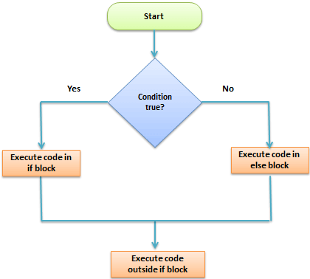
How it’s work?

Slide 5
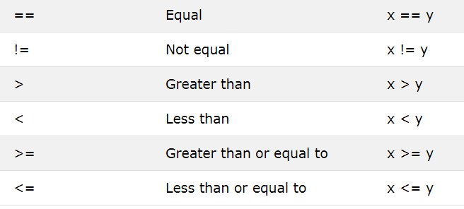
Python Comparison Operators

Slide 6
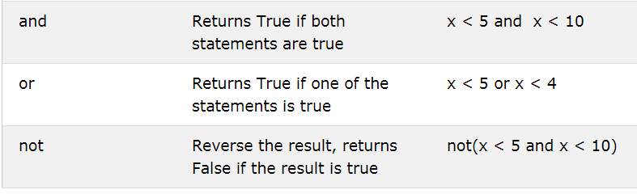
Python Logical Operators

Slide 7
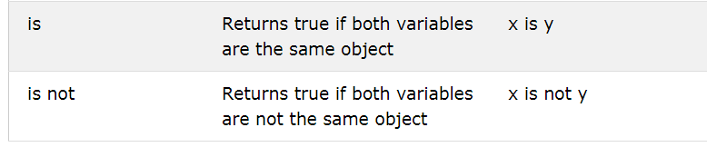
Python Identity Operators

Slide 8
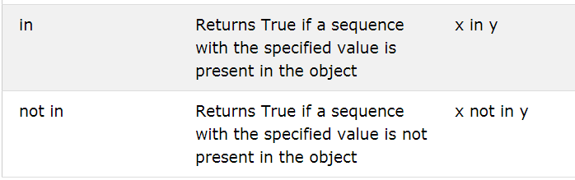
Python Membership Operators

Slide 10
Problem
Write program to find positive and negative
Write program to find a number Even and Odd
Write program to find smallest from three number.
Write program to check a word is palindrome or not

